Slide 1
Text Data analysis with BigML
Aditya Nanjappa
College of Computing & Informatics
Drexel University
Philadelphia, PA 19104

Slide 2
BigML
With the motto of bringing Machine Learning to everyone, BigML was introduced in 2011.
BigML is a consumable, programmable, and scalable Machine Learning platform that makes it easy to solve and automate Classification, Regression, Time Series Forecasting, Cluster Analysis, Anomaly Detection, Association Discovery, and Topic Modeling tasks.
This video demonstrates briefly on what BigML does.
https://www.youtube.com/watch?v=FAICjPh9a78#action=share
2

Slide 3
BigML: Uses
BigML is helping thousands of analysts, software developers, and scientists around the world to solve Machine Learning tasks "end-to-end", seamlessly transforming data into actionable models that are used as remote services or, locally, embedded into applications to make predictions.
It can be used for both
  Supervised Learning: classification and regression (trees, ensembles, linear regressions, logistic regressions, deepnets), and time series forecasting.
  Unsupervised Learning: cluster analysis, anomaly detection, topic modeling, association discovery, and Principal Component Analysis (PCA).
3

Slide 4
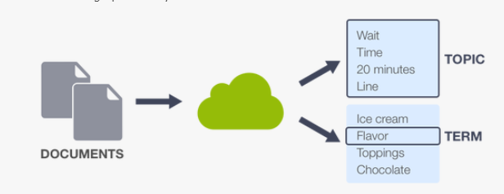
Text Data Analysis using BigML
Text data analysis allows us to understand unstructured text data analysis and makes it easier on what the text convey, thus help business deal with information overload.
This helps us to extract information like key words, names, sentiment and label them accordingly to our needs.
Text analysis in BigML is done through Topic Models.

Slide 5
Topic Models
In machine learning and natural language processing, a topic model is a type of statistical model for discovering the abstract "topics" that occur in a collection of documents.
Basic assumptions of topic modeling is that each ‘Document’ is a mixture of ‘Topics’ and each ‘Topic’ consists of a collection of ‘Word’. (This is the idea behind LDA)
Major Topic Models are:
  Latent Semantic Analysis (LSA)
  Probabilistic Latent Semantic Analysis (pLSA)
  Latent Dirichlet Allocation (LDA)

Slide 6
Latent Dirichlet Allocation (LDA)
BigML uses its own implementation of LDA for Text Data analysis.
It tries to find significant thematically related ‘Topics’ from the supplied unstructured data.
The topics that we get can be used for modelling tasks.
The idea behind LDA is that ‘Each document can be described by a distribution of topics and each topic can be described by a distribution of words’
Latent – Hidden
Dirichlet – A type of probability distribution

Slide 7
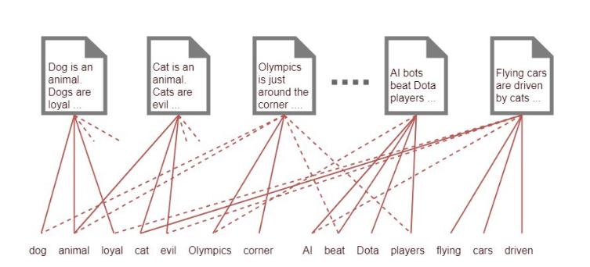
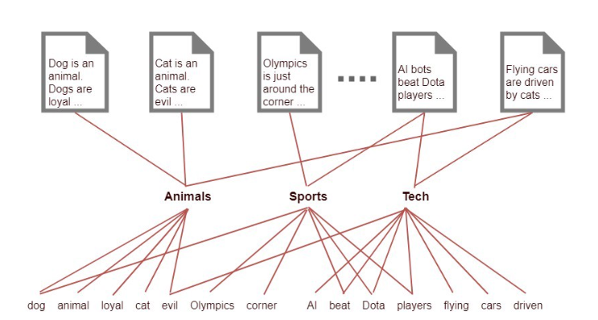
Latent Dirichlet Allocation (LDA)
Fig1 : Representing words
Fig2 : Representing Topics
Source: Thushan Ganegedara

Slide 8
Latent Dirichlet Allocation (LDA)
In Fig 1, we are provided with multiple documents. Each document has the words specified in them.
Ins Fig 2, we add a latent (hidden) layer, that creates a topic. With this, we can say that each document is related to certain document.
With this, we can now classify the document with certain Topics and with this topic probability distribution, we can say what this document is really talking about.
Now we can say that these documents talk about ‘Animals’, ‘Sports’ and ‘Tech’
Note: ‘Animals’, ‘Sports’ and ‘Tech’ are imaginary. It is our responsibility to understand what the output ‘Topic’ is talking about.

Slide 9
Specification of LDA
Input: A document Term matrix (It is a matrix where the rows are different documents and columns are the words of the document), Number of Iterations, Number of Topics.
Topic Model: This is where the LDA works. To improve efficiency, we need to use nltk for some parts of speech tagging. This is done by BigML implementation.
Output: Document tagged with the model with highest probability distribution.

Slide 10
How LDA works
Assumptions:
Topic A - Animals
Topic B - Sports
Topic C - Tech
Step 1 : We first choose the number of topics that might be in the document. In our example, its K=3.
Step 2 : LDA randomly assigns each word of each document into one of the 3 topics. EX: The word ‘dog’ is randomly assigned to topic B.

Slide 11
How LDA works
Step 3 : After random assignment, LDA go through every word and its topic assignment. Now it sees how often this topic occurs in the document and how often the word occurs in the topic. Ex: Dog was previously assigned to sports. It is unlikely that it appears in the sports. So it will reassign it to a different topic ie. Topic A.
We have to make multiple iterations for the topics to make any real sense.
Step 4 : Then we must interpret the topics and figure out what the topics mean.

Slide 12
Topic Modeling with BigML
Data Description:
  (Format: .csv)
  publish_date: Date of publishing for the article in yyyyMMdd format
  headline_text: Text of the headline in Ascii , English , lowercase
  Start Date: 2003-02-19 ; End Date: 2019-12-31

Slide 13
Steps:
We start by loading the .csv file into BigML
2. We will convert it into dataset. We will use one click dataset.
As this has Date-Time field, BigML automatically creates Year, Date, Month and Day of the week field.
3. There are 6 fields in the dataset. We will concentrate just on text field.

Slide 14
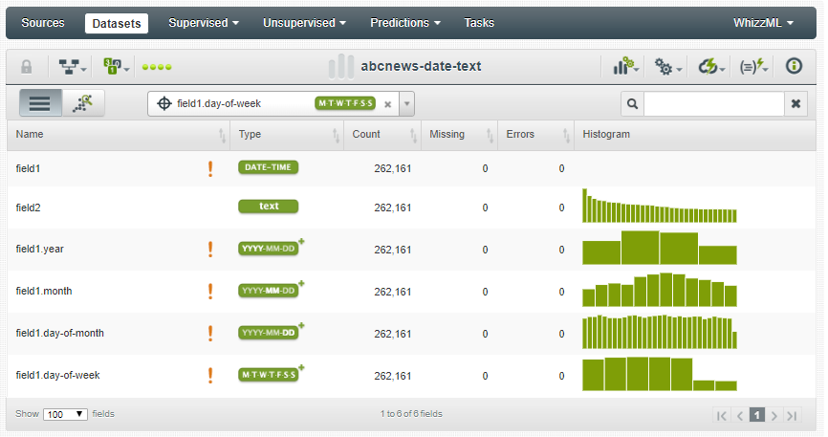

Slide 15
Exploratory Data Analysis:
We can see the histogram of the text field on the right side.
We can hover on this histogram and find the number of instance of top words within the document.
We see that the word ‘Police’ has the highest number of instances in the document. We can create a tag cloud by clicking on the cloud text icon.

Slide 16
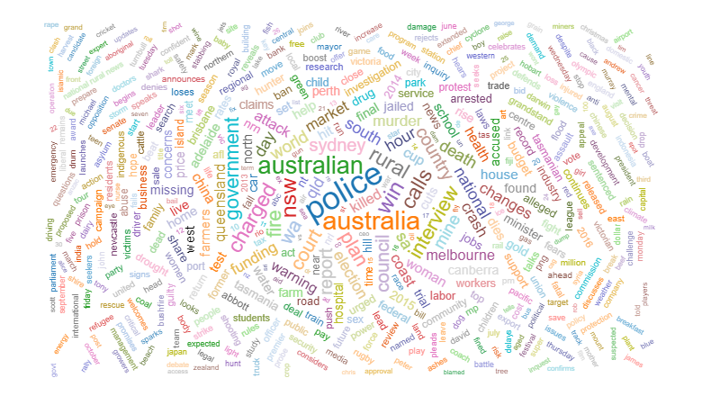
Text Cloud representation

Slide 17

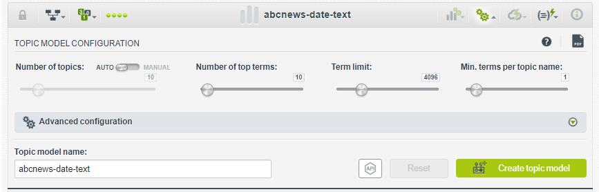
Configuring Topic Model
BigML provides us with options to configure the model we are building.
Selecting ‘Topic Modeling’ from the gear icon will allow you to configure the model.

Slide 18

Basic Configuration:
Number of Topics: We have an option to automatically set the number of topics. We can switch to manual to set it into a predefined value. ( We have to switch from auto to manual to do this)
Number of Top Terms: This determines number of terms each topic can have.
Term Limit: The total number of unique terms to be considered for the Topic Model vocabulary. By default it is set to 4,096, the maximum is 16,384 unique terms.

Slide 19
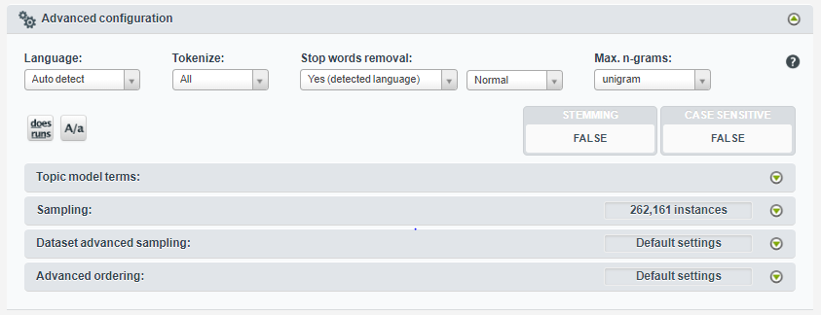
Advanced Configuration

Slide 20
Advanced Configuration
Language: BigML supports 22 languages. By default it is in ‘Autoselect’. We also have an option to select one among the list.
Tokenize : We can tokenize all the words or only the tokens. By default Topic Models will always tokenize your text fields by terms
Stop words removal: Stop words such as ‘a’, ‘an’, ‘in’ will be automatically detected and removed by BigML.
Max n-grams: Whether the Topic Model, apart from single terms, should include pairs of terms that typically go together (e.g.: “United States” or “mobile phone”). By default this option is not active and selected to Unigram.

Slide 21

Advanced Configuration
Topic Model Terms: BigML topic model provides options to exclude non dictionary words, exclude non-language characters, exclude HTML keywords like <include>, exclude numbers. Apart from all these, we can also exclude a particular topic.

Slide 22
Creating Topic Model:
Specifications:
  Number of Topics – 15
  Terms per Topic – 20
  Stemming – True
  Filter – Exclude non dictionary words
  Exclude Non-language characters
  Exclude HTML
  Exclude Numbers
  Everything else – Default
  Click on Create Model

Slide 23
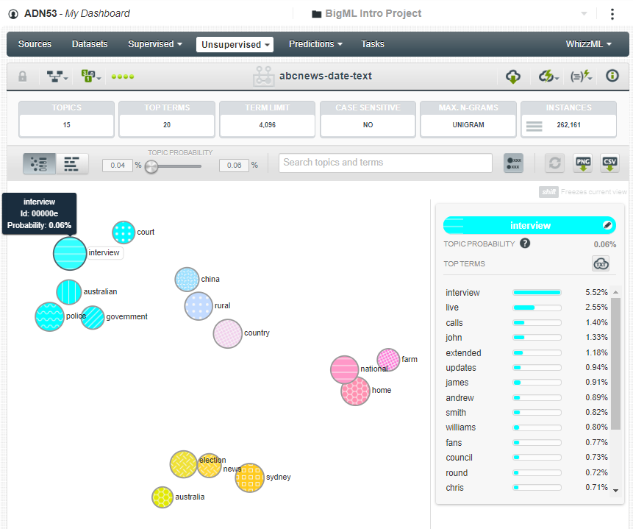
Result of Topic Modeling

Slide 24
Analyzing the Topic Model – Topic Map
This image shows topic as a map view, where you can get a sense of both the topic importances and the relationship between them. Each circle represents a different topic, and its size depicts the “Topic probability” — this is the average probability of the topic to appear in a given instance of the original dataset. The distance between the circles represents how close or far topics are thematically speaking.
By mousing over each topic you can see the top most important terms for that topic.
The terms are ordered by their importance within each topic as measured by the “Term probability”. All term probabilities for a given topic should sum up to 100%.

Slide 25
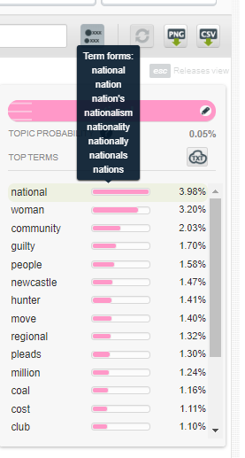
Analyzing Topic Model – Topic Map
If you mouse over each term within a topic, you will find all the stemmed forms for that term.
Stemming is the process of taking just the lexeme for the terms so e.g. the terms “nation”, “nation’s” and “nationalism”, are considered the same term, since they all have the same lexeme: “nation”.

Slide 26
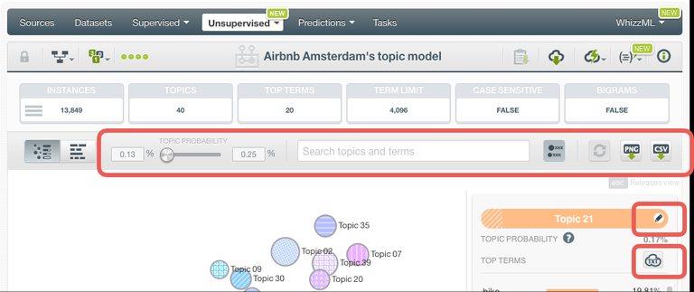
Analyzing Topic Model – Topic Map
Filtering options:
  Topic probability slider to filter the topic circles by size (importance) i.e., the average probability of a topic in a given instance in the original dataset used to create the model.
  Search box to filter topics and terms.
  Include/exclude labels for topics.
  Reset filters option.
Export options:
  Export map in PNG format.
  Export model in CSV format.
Edit topic names by clicking in a Topic circle, and you can change its name by using the edit icon. This is very useful to interpret the main theme of each topic, when you make predictions afterwards.
Tag cloud to see the terms composing a topic in a tag cloud.

Slide 27
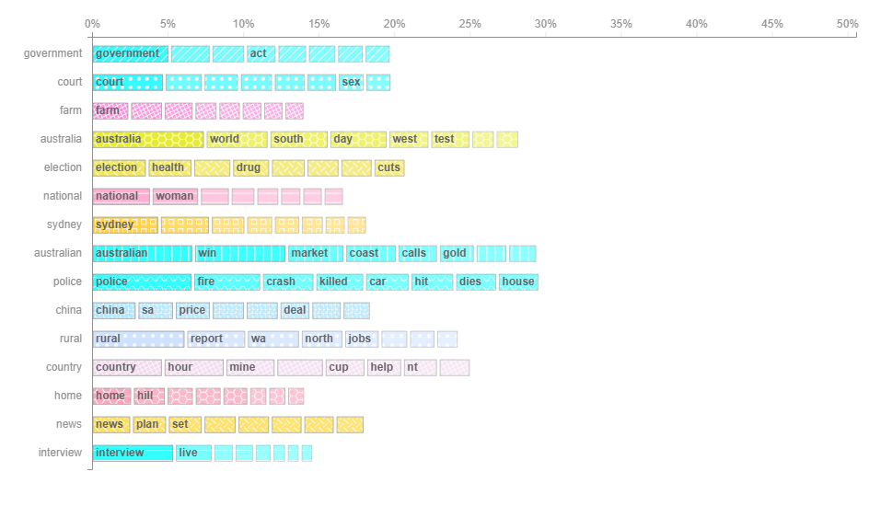
Analyzing Topic Model – Term Chart
This view shows the topics and their terms in a bar chart to give you a quick overview of the terms composing the topics as well as their importance.
In the horizontal axis, you can see each term probability for each of the top terms of a given topic

Slide 28
Analyzing Topic Model – Term Chart
The chart has the following options found in the top menu:
Filtering options:
  Term probability slider to filter terms by their probability in a given topic.
  Search box to filter topics and terms.
  Number of terms to select the maximum terms shown per topic in the chart.
  Dynamic axis option to adjust the axis scale to the current filters.
  Reset filters option.
Export options:
  Export chart in PNG format (with or without legends).
  Export model in CSV format.

Slide 29
Making Predictions
The objective of Topic Modeling is to find the relevant topic for the dataset of instances.
BigML also allows you to make predictions for a single instance, Topic Distribution, or for several instances simultaneously, Batch Topic Distribution.

Slide 30
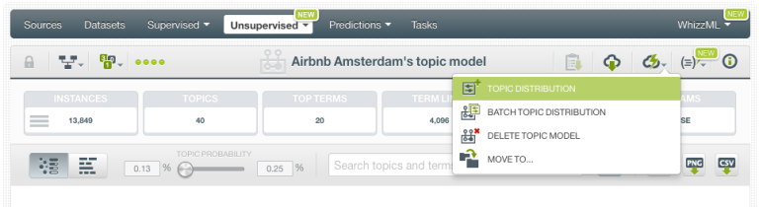
Topic Distribution:
To get one single prediction for an input text, click the Topic Distribution option as shown in the image below.

Slide 31
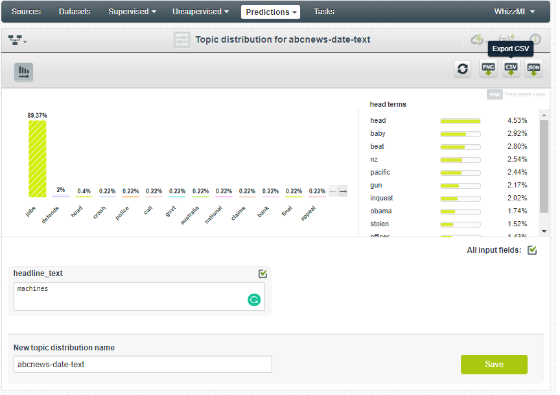
Topic Distribution
You will get a form containing the input fields used to create the Topic Model. Include any text in the corresponding input field boxes.
BigML automatically computes each topic probability for that input text.
You can see topic probabilities in a histogram like the one shown in the image below.
You can also see the terms within each topic by mousing over each topic.

Slide 32
IMDB Movie Sentiment Analysis:
As we now have an idea about how topic modeling in BigML works, we will extend it to Sentiment analysis using BigML.
We are using movie reviews extracted from the IMBD database to predict if a given review has a positive or a negative sentiment.
Data source: https://www.kaggle.com/lakshmi25npathi/imdb-dataset-of-50k-movie-reviews
We loaded the data ‘IMDB Dataset.csv’ and created the dataset.
Data Features:
It has two features, REVIEW and SENTIMENT.
REVIEW is the text data.
Sentiment is a label defining if the review was positive or negative.

Slide 33

Creating a decision tree
To get a first sense of whether the text in the reviews have any power to predict the sentiment, we are going to build a single decision tree by selecting the “sentiment” as the objective field and using the reviews as input.
If we perform a 1-click model, we obtain the decision tree in a few seconds. As you mouse over the root node and go down the tree until you reach the leaf nodes, you can see the different prediction paths.

Slide 34
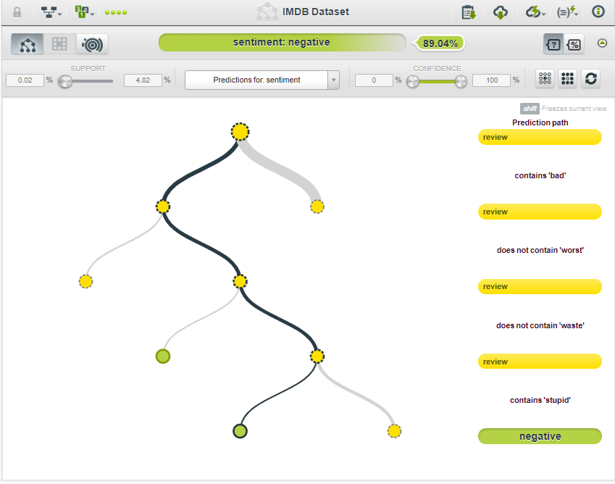
Example decision tree:
This decision tree shows that if the text has following words, then it is a negative comment with a confidence of 89% which is good.
Now we know that this data can be used to perform sentiment analysis.

Slide 35
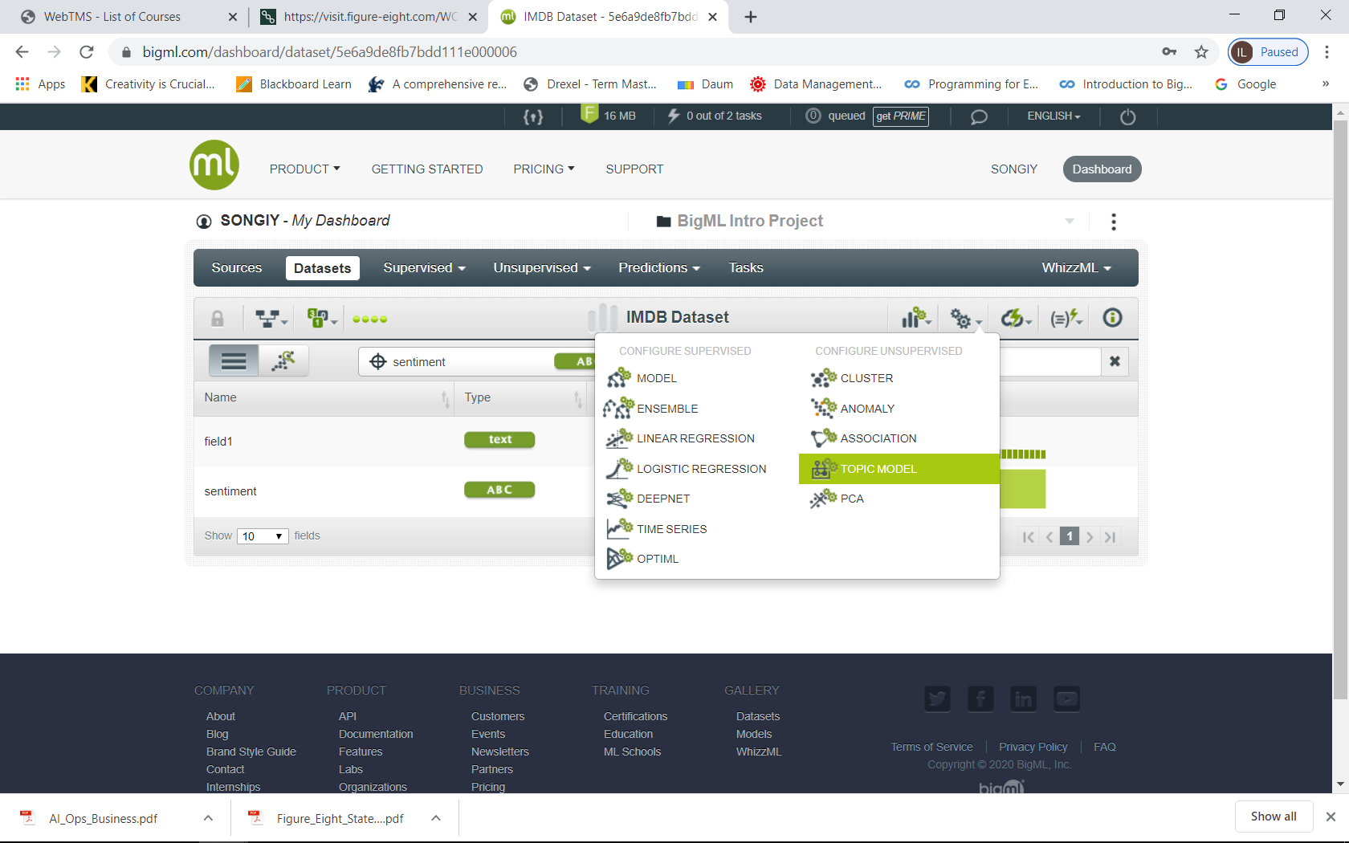

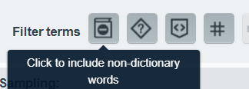
Topic Modeling
This data has HTML tags, numbers
etc which is not useful for topic modeling.
Hence we need to clean the data to perform Topic Modeling.
We will use advanced configuration of topic model to clean the data.
  We neglect HTML codes, go to Advanced Configuration
  We neglect Numbers
Use arrow key to increase #topics manually

Slide 36



Topic Modeling
In the first view, you will be able to see at-a-glance all the topics represented by circles sized in proportion to the topic importances. Furthermore, the topics are displayed in a map layout, which depicts the relationship between them such that closer topics are more thematically related.
We will now look into the bar chart. Each term is represented by a bar whose length signifies the importance of the term within that topic
We see that Topics like Bad, life, funny help us to determine the type of the movie.
You can rename the topic name with pencil icon

Slide 37

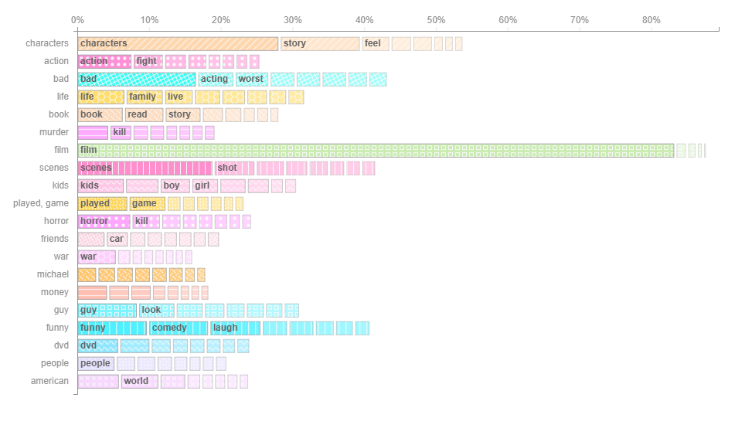
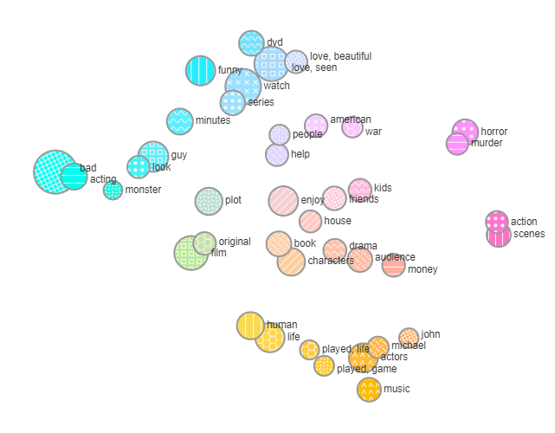
Topic Modeling

Slide 38
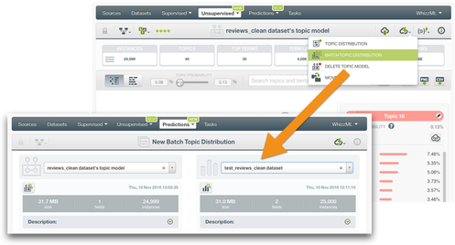
Evaluation
Now that we have seen that the topics discovered in our dataset seem to follow a general logic that may be useful to predict sentiment, we can include them as predictors. You can easily achieve this by performing a Batch Topic Distribution.

Slide 39
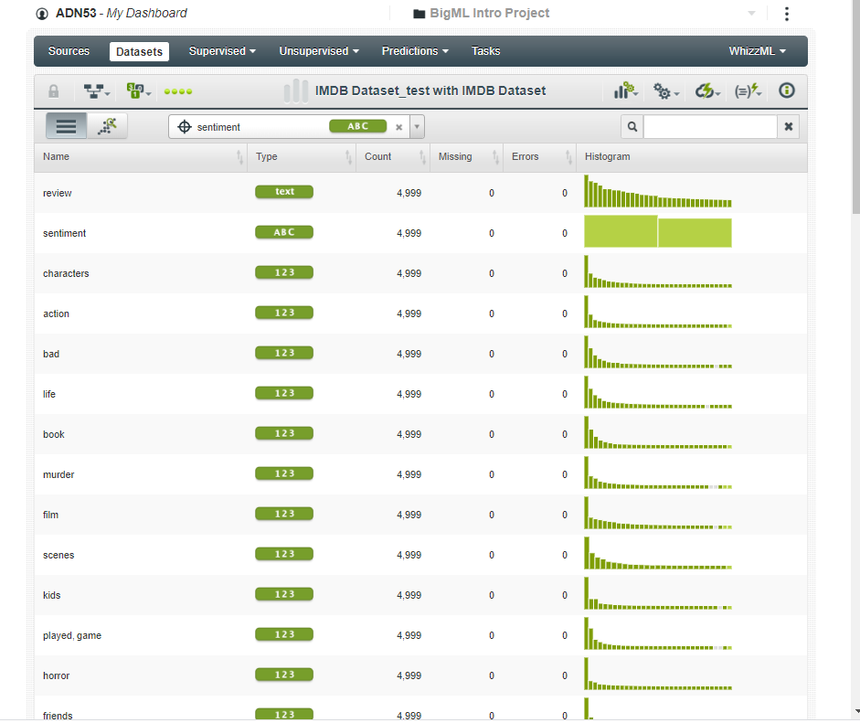
Evaluation
When the Batch Topic Distribution is created, we can access the dataset that contains the topic distributions. As seen below, a new field per topic is created whereby its values represent the probabilities for each of the instances.

Slide 40
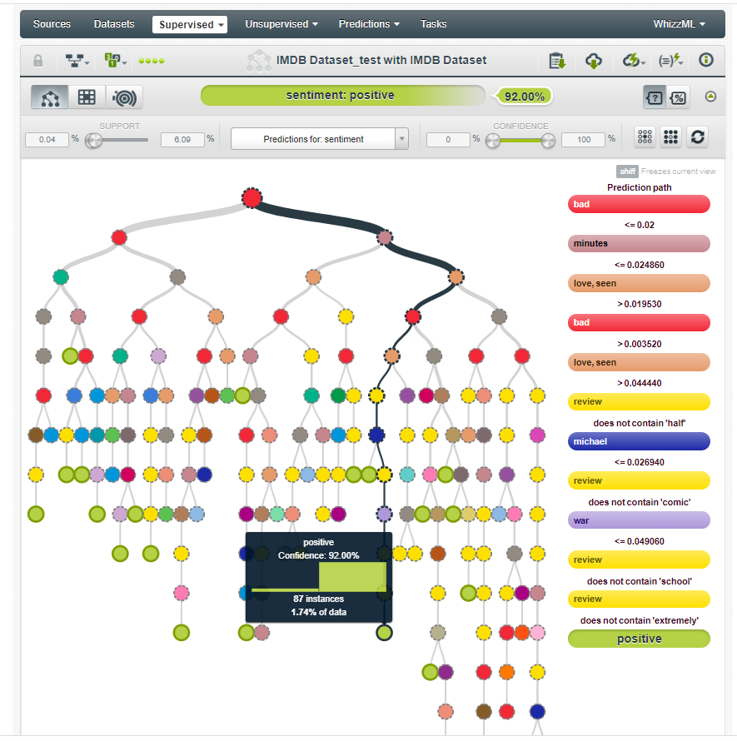
Evaluation:
Now we can recreate a model by using the topics as input fields. Amazingly, the resulting tree is very different from the one created before. Now the most important values to predict sentiment are not the single terms anymore, but the topics!

Slide 41
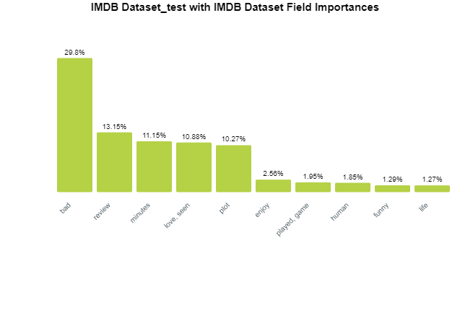
Model Summary Report
With this report, we see that the topic ‘Bad’ is of highest priority to determine the sentiment of the text.

Slide 42
Sources:
https://youtu.be/XmF61NxrDJs
https://towardsdatascience.com/light-on-math-machine-learning-intuitive-guide-to-latent-dirichlet-allocation-437c81220158
https://blog.bigml.com/2018/07/12/text-analysis-enhancements-22-languages-and-more-pre-processing-options/
https://blog.bigml.com/2016/11/16/introduction-to-topic-models/
https://youtu.be/OjKJp5kvpNs?list=PL1bKyu9GtNYHcjGa6ulrvRVcm1lAB8he3
https://blog.bigml.com/2016/11/25/who-wants-to-know-the-inner-workings-of-lda/

Slide 43

Question?

